Slide 1
So…What Is a Celt?

Slide 2
At this point, we need to regroup & consider everything we’ve learned.
What is a Celt? Is it a biological descendant of the Keltoi? If so, there appear to be relatively few, and relatively few of those relatively few live in the islands. It’s very likely none of them speak a Celtic language.
Is it someone whose native language is a Celtic language? Although there is a push, particularly strong in Ireland, for the learning of the Celtic language that’s still spoken by some in the country, that’s not the same thing as having native speakers of the language. The effort COULD lead to that; there is a precedent. Hebrew had been no one’s native language since the second century A.D. In the late 1800s, there was an effort to revive it. Now it’s one of the two official languages of Israel, & it is the native language of 50% of the population of 8.5 million. With what you now know about language, it should not surprise you that the historical language of the Jews is one that would be resurrected. Jews are a group for whom identity is highly important, & since language is such an important part of identity…well, to put it succinctly, it makes sense.
But back to the question of Celtic language: if we say that a Celt is someone whose native language is a Celtic language, we have very few Celts these days. If we expand it to someone who has learned a Celtic language, that’s more people, but really, if a Japanese person chooses to learn Gaelic, would we call him a Celt?

Slide 3
The consensus seems to be that a Celt is someone who is a native of Ireland, Scotland, Cornwall, Wales, Brittany, or the Isle of Man. In other words, they are natives of countries or regions where a Celtic language is spoken or has been spoken in modern (as opposed to ancient) times.
We can conclude, then, that Celtic culture is the culture of these 6 lands. Of course, there is variation among those cultures. Although we’re not going to dig into it, you need to consider the fact that Celtic culture today is the result of the initial influence of the Keltoi, especially during the La Tène period, plus the influence of Celtomania—along with the natural growth & change that are true of any culture. Knowing about druids and that the Celts pre-dated the birth of Christ, do you not find the notion of a Celtic cross somewhat ironic? But the Celts, like the rest of the western world, became Christianized, and the culture of Christianity blended with other elements of their culture.

Slide 4
This course focuses on Ireland, but this would be a good time to look briefly at the other 5 countries/regions.

Slide 5
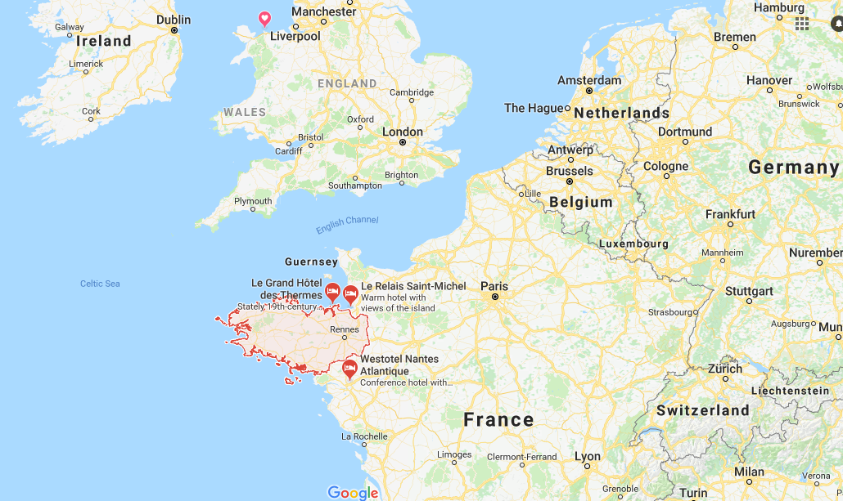
Brittany
Brittany, a region of France, occupies a northwestern peninsula. If you’d been asked to name Celtic countries or regions, Brittany probably would have been somewhere below “England” & “Australia” on your list of guesses, assuming you’d ever even heard of it.
When you think about it, it’s not so strange that Brittany is a Celtic region. Remember that Gaul, roughly equivalent to modern-day France, was part of the Celtic lands when the Celts first came into the prehistoric picture around 600 B.C. The first known name of the peninsula where Brittany is located, Aremorio, was a Celtic word meaning “near the sea.” It is still sometimes known as Armorica, which is the Romanized version of Aremorio. It is believed that the Celts may have first arrived there in the 5th century B.C., & several tribes occupied the peninsula by the first century A.D.
And then came Caesar. He defeated the Celts in Armorica, and many fled to Britain or Ireland, which hadn’t been invaded yet, & some fled inland. When the troops left, some Celts returned to the peninsula. Caesar invaded Britain then, & Rome controlled it until about 410 A.D. Oddly enough, Latin didn’t take hold in Britain, which continued to speak a Celtic language known as Brittonic. At the end of Roman rule, Germanic tribes began invading Britain, and just as many Celtic peoples had fled from the Romans, many
now fled from the Germans. As you can see, the Armorica peninsula is reasonably close to Britain, so many Britons, as the Celts there were known, fled there. Brittany takes its current English name from those people. In French, it is called Bretagne, and Great Britain is Grande-Bretagne.
The population of Brittany is over 3 million, but only about 200,000 people speak Breton. As in the other Celtic-speaking countries, there is an effort to revive the language. Unsurprisingly, the majority of people speak French.

Slide 6
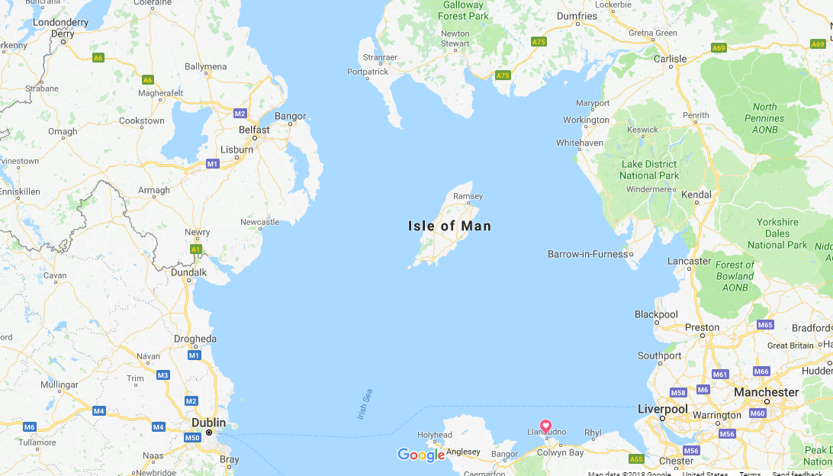
Isle of Man
The Isle of Man, located in the Irish Sea, has a pre-history & early history similar to that of Ireland, which isn’t surprising, considering their proximity & the small size of Man.
At this point, we’ve studied only Ireland’s pre-history, not its history, but suffice it to say that in both locations there were Viking invasions and English invasions.

Slide 7
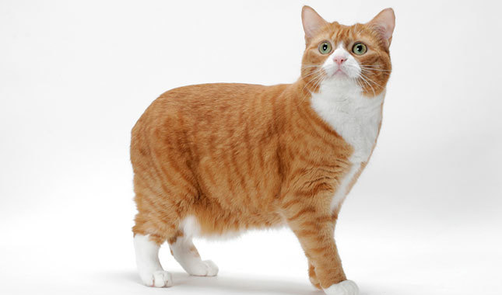
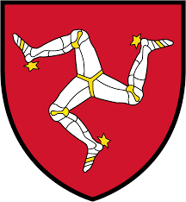
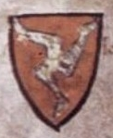
Interesting facts about the Isle of Man:
The Manx cat, which is tailless, is native to the Isle of Man.
The modern symbol on the Manx flag & coat of arms is based on a coat of arms that dates to the 13th century.

Slide 8
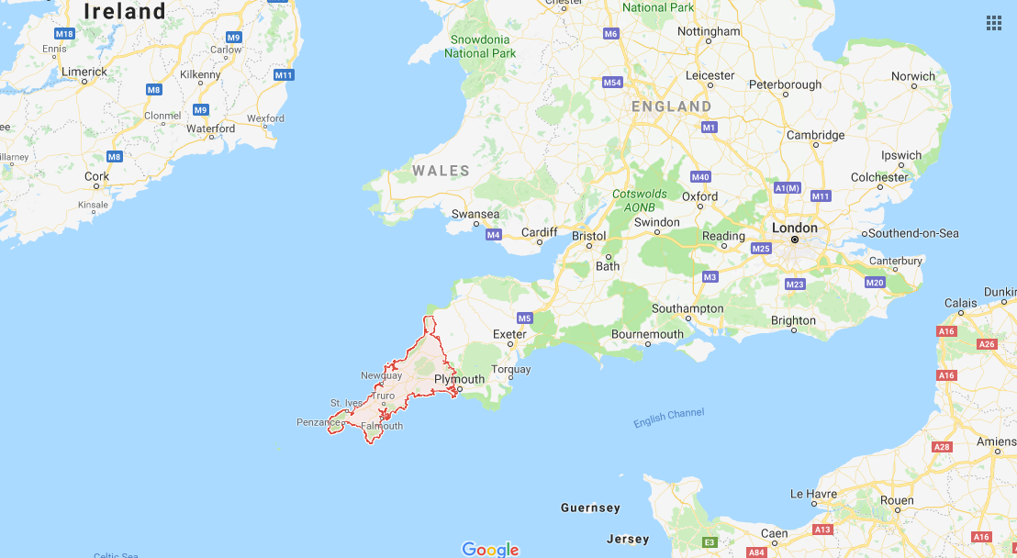
Cornwall
Cornwall is a southwestern peninsula of Britain. You should see a pattern developing: people fleeing invaders went to peninsulas and islands. Britain itself is an island, of course, but bigger than Ireland & much bigger than the Isle of Man.
Rome conquered
Cornwall along with
most of the rest of
Britain. But once
they’d established a
center at present-day
Exeter, they didn’t go
much farther, &
life in Cornwall
continued pretty
much as it had before.

Slide 9
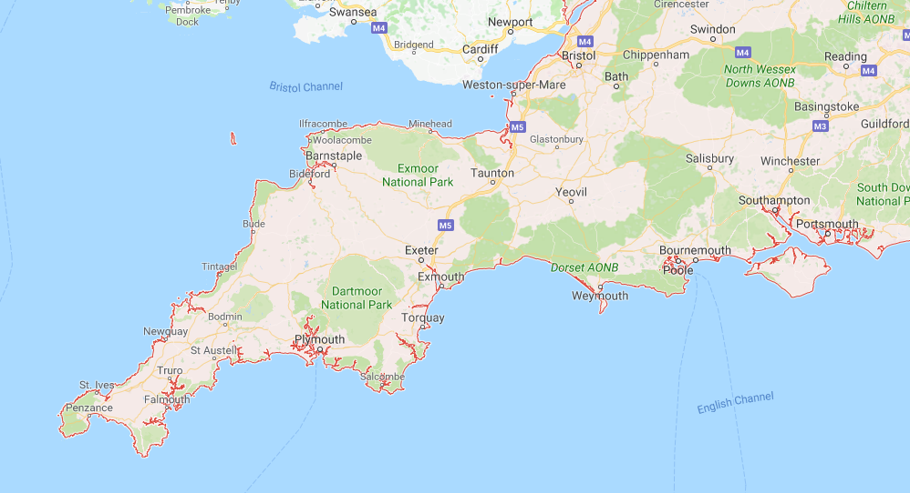
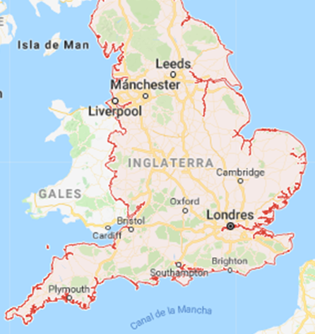
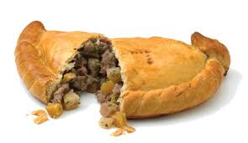
The Germanic tribes were a different story. They worked their way into the peninsula & took it over as well as what is now England. Their influence was obviously stronger in Cornwall than any of the other regions/countries where a Celtic language survived into modern times, since Cornish died out over 200 years ago. Now Cornwall is a county of England.
Cornwall has several claims to fame. Gilbert & Sullivan’s operetta “The Pirates of Penzance” has kept that coastal town on the map, so to speak.
Pasties originated in Cornwall & are
frequently referred to as Cornish
pasties. They are meat turnovers with
a thick, crimped edge so that miners
with dirty hands could hold the edge
to eat.

Slide 10
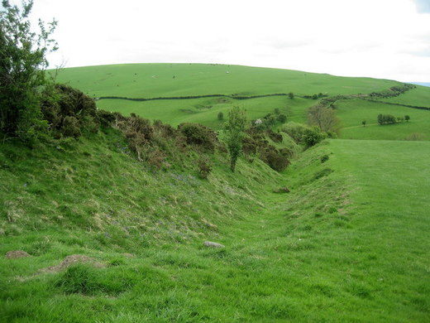
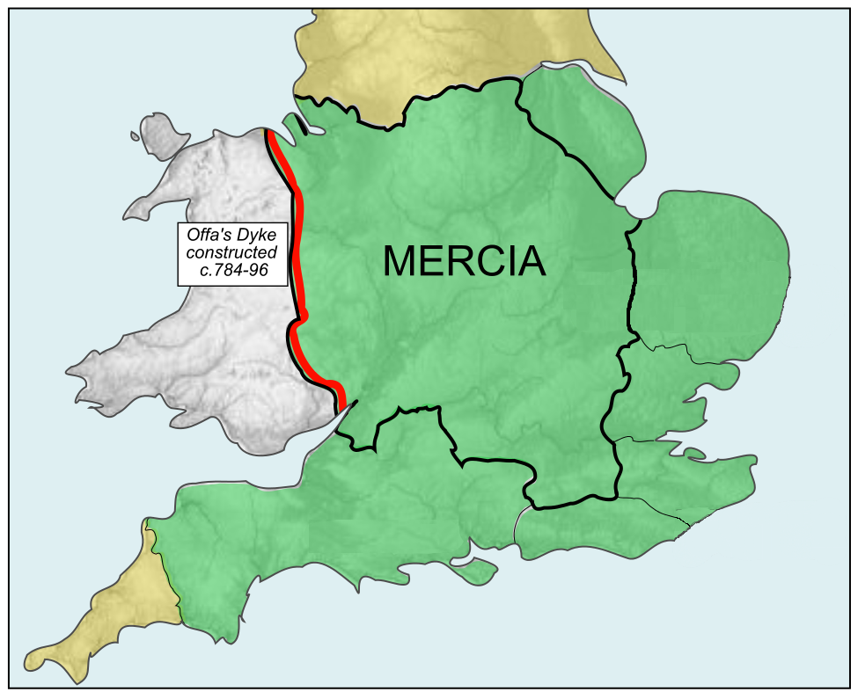
Wales
As has been mentioned, the Welsh are refugees from the Anglo-Saxon invasion of the island. The Anglo-Saxons actually drew a literal line in the (non-literal) sand. In the late 700s A.D., Offa, the Anglo-Saxon king of Mercia (now the English midlands), ordered the construction of what is now known as Offa’s Dyke. It runs along the entire Welsh border, so Offa defined what is now Wales. The purpose of the dyke is a question of debate, although it wouldn’t have been much of a defense. In any case, as the Encyclopedia of Wales states, “the separateness of Wales is signified in the border landscape by the presence of this monumental earthwork, the biggest engineering project in Europe at the time of its construction in the eighth century“ (http://www.bbc.co.uk/blogs/wales/entries/c7d7742c-0ef4-3c7f-992c-2193ee27c5c2). That Anglo-Saxon king did the Welsh & their language & culture a big favor by digging that ditch and literally drawing a line between Wales & what would become England; it’s much more likely that it would have all been swallowed up by England, as was Cornwall, without Offa’s Dyke.

Slide 11
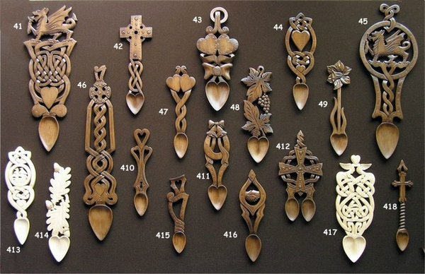
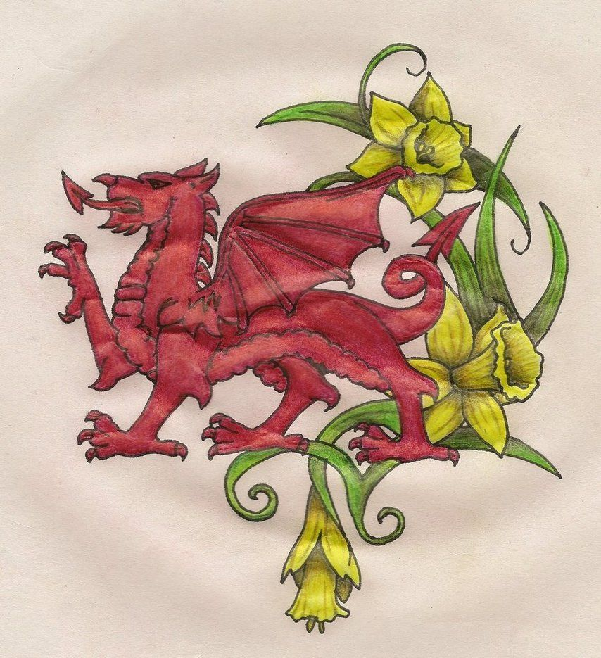
Interestingly, the island of Anglesey was an important druidic site around the time of Christ. What we know comes from the story of Rome’s conquest of it, but apparently, it was a place where druids from all over went to learn.
Another note of interest is that Wales has more castles per square mile than any other country in Europe. The oldest remaining one dates to 1067.
Symbols of Wales are the red dragon (which is on the Welsh flag & whose origins are uncertain) and the yellow daffodil.
In souvenir shops in Wales, you find intricately carved wooden love spoons. Click here for the story behind them: http://www.welsh-love-spoons.co.uk/history

Slide 12
In a Celtic Heritage class at Gordon State College, home of the Highlanders, Scotland deserves its own slide show.

